Slide 1
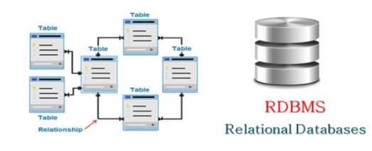
What is RDBMS ?
RDBMS stands for Relational Database Management Systems.
All modern database management systems like SQL, MS SQL Server, IBM DB2, ORACLE, My-SQL and Microsoft Access are based on RDBMS.

Slide 2
How it works ?
Data is represented in terms of tuples (rows) in RDBMS.
Relational database is most commonly used database. It contains number of tables and each table has its own primary key.
Due to a collection of organized set of tables, data can be accessed easily in RDBMS.

Slide 3
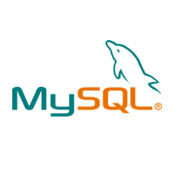
What is MySQL?
MySQL is currently the most popular database management system software used for managing the relational database. It is open-source database software, which is supported by Oracle Company.
It is commonly used in conjunction with PHP scripts for creating powerful and dynamic server-side or web-based enterprise applications.

Slide 4
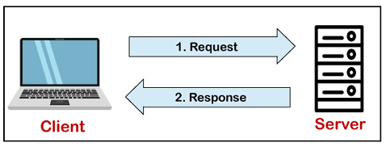
How MySQL Works?
MySQL follows the working of Client-Server Architecture. This model is designed for the end-users called clients to access the resources from a central computer known as a server using network services. Here, the clients make requests through a graphical user interface (GUI), and the server will give the desired output as soon as the instructions are matched. The process of MySQL environment is the same as the client-server model.

Slide 5
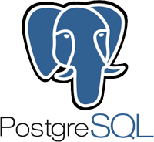
What is PostgreSQL?
PostgreSQL is an ORDBMS [Open-Source Object-Relational Database Management System]. It is used to store data securely; supporting best practices, and allow recovering them when the request is processed.
The primary objective of PostgreSQL is to handle a variety of jobs from single technologies to web service or the data warehouse with several parallel users.

Slide 6
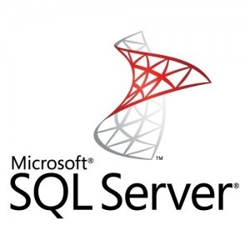
What is SQL Server?
The relational database management system (RDBMS) is a Microsoft software product mainly used to store and retrieve data for the same or other applications. We can run these applications on the same computer or a different one.

Slide 7
Usage of SQL Server
The following are the key usage of MS SQL Server:
Its main purpose is to build and maintain databases.
It is used to analyze the data using SQL Server Analysis Services (SSAS).
It is used to generate reports using SQL Server Reporting Services (SSRS).
It is used to perform ETL operations using SQL Server Integration Services (SSIS).

Slide 8
SQL Server as Client-Server Architecture
SQL Server is based on a Client-Server Architecture and is intended for end-users known as clients who send requests to the MS SQL Server installed on a particular computer. The server will give the desired output as soon as the processing input data is requested. This server is available as a separate program and responsible for handling all the database instructions, statements, or commands. The SQL Server Database Engine, which controls data storage, processing, and security, is thus the core component of MS SQL Server.

Slide 9
MySQL vs PostgreSQL vs SQL Server
 | MySQL | PostgreSQL | SQL Server
Price | has additional paid tools; the core functionality can be accessed for free. | open-source | the database has a free edition for developers and small businesses but only supports 1 processor, 1GB of maximum memory used by the database engine and 10GB maximum database size.

Slide 10
MySQL vs PostgreSQL vs SQL Server
 | MySQL | PostgreSQL | SQL Server
Language | written in C++; database management is done with Structured Query Language. | Written in C | Written in C,C++

Slide 11
MySQL vs PostgreSQL vs SQL Server
 | MySQL | PostgreSQL | SQL Server
Data changes | a solution updates data automatically to the rollback storage. If something goes wrong, developers can always go back to the previous version. | developers insert a new column and row in order to update the database | the database has three engines that are responsible for row updates. The ROW Store handles the information on all previous row updates

Slide 12
MySQL vs PostgreSQL vs SQL Server
 | MySQL | PostgreSQL | SQL Server
Data Queries | offers a scalable buffer pool – developers can set up the size of the cache according to the workload. | Each database has a separate memory and runs its own process | uses a buffer pool, and just like in MySQL, it can be limited or increased according to processing needs.

Slide 13
MySQL vs PostgreSQL vs SQL Server
 | MySQL | PostgreSQL | SQL Server
Memory-Optimized Tables | supports the memory-stored table, but it can’t participate in transactions, and its security is highly vulnerable | doesn’t support in-memory database creation. | uses an optimistic strategy to handle memory-optimized tables, which means they can participate in transactions along with ordinary tables.

Slide 14
MySQL vs PostgreSQL vs SQL Server
 | MySQL | PostgreSQL | SQL Server
JSON Support | supports JSON files but doesn’t allow indexing them | supports JSON files, as well as their indexing and partial updates. | also provides full support of JSON documents, their updates, functionality, and maintenance

Slide 15
CONCLUSION
The choice between the three most popular databases ultimately boils down to the comparison of the functionality, use cases, and ecosystems. Companies that prioritize flexibility, cost-efficiency, and innovation usually choose open-source solutions. They can be integrated with multiple free add-ons, have active user communities, and are continuously updated.

